Slide 1
SPLENDOR INSURANCE ANALYTICS DASHBOARD
Data Interpretation

Slide 2
Agenda
Introduction
Data Exploration
Model Development
Interpretation

Slide 3
Introduction
Outline Problems
Splendor Analytics Insurance is a company specializing in offering a variety of insurance products to its customers.
The company's portfolio includes auto insurance, which covers losses or damages related to vehicles.
The provided dataset contains anonymized information about the policyholders, their vehicles, and their claim histories.
The goal of this project is to analyze this dataset to uncover insights that can help Splendor Analytics Insurance improve its services, optimize premiums, and reduce claim costs.
Contents of Data Analysis
Claim Frequency and Amount Analysis
Risk Assessment
Premium Optimization
Customer Segmentation and Marketing
Demographic Analysis
Geographical Analysis
Customer Behavior Insights

Slide 4
The aims of Splendor Analytics Insurance to enhance its auto insurance division by leveraging data analysis
Identify patterns in claim frequencies and amounts.
Understand the demographics and characteristics of high-risk and low-risk policyholders.
Optimize premium pricing models based on risk factors.
Develop targeted marketing strategies to attract and retain customers.

Slide 5
Data Exploration
Data Quality Assessment and ‘Clean Up’
Dataset | Accuracy | Completeness | Consistency | Validity | Relevancy
Insurance Policy | ID: Accurate | New Age : Absence | Gender: consistency | - | -
 |  | Age Group: Absence
Key Issues for Data Quality Assessment
Accuracy: Correct Values
Completeness: Data fields with Values
Consistency: Values free from Contradiction
Currency: Values up to Date
Relevancy: Data items with Values Mete-data
Validity: Data containing Allowable Values
Uniqueness: Records that are Duplicated

Slide 6
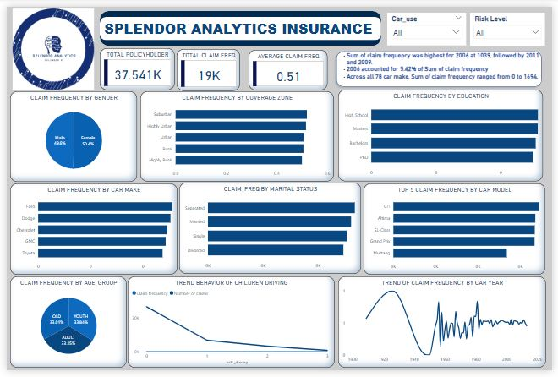
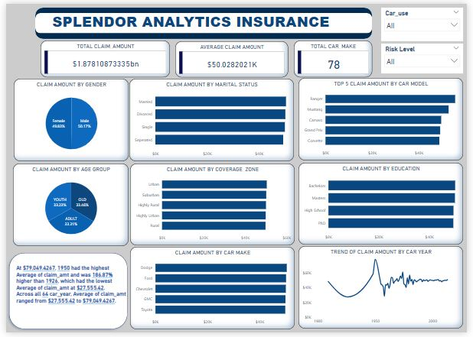
CLAIM FREQUENCY AND AMOUNT MODEL

Slide 7
CLAIM FREQUENCY AND AMOUNT ANALYSIS
Without filters, we noticed the following;
Total claim frequency is 15,000, the claim frequency range between 0 – 4
On average, there is about half a claim per policy across the dataset.
Gender- Males scored 49.95% and females, 50.05% on the claim frequency, while Females scored 49.83% and Males, 50.17% on the claim amount.
Education- PhD has the largest claim frequency, followed by High School, then Master’s. Bachelor’s has the lowest claims frequency, while Bachelor’s has the largest claim amount, followed by Master’s, then High School. PhD has the lowest claims amount.
Marital Status - Separated policyholders have the most claim frequency, then Single, Married, and Divorced respectively, while Married policyholders have the most claim frequency, then Divorced, Single, and separated respectively.

Slide 8
Car Makes- we looked into a chart of the top 5 car make for claim frequency, Daihatsu leads, followed by Holden, Merkur, and Peugeot, and Ram holds the 5th position while for claim amount, Hillman leads, followed by Holden, Corbin, and Daihatsu, and Fairthorpe holds the 5th position
Car Model- Also looked into a chart of the top 5 car models to claim frequency, 207 leads followed by 228, 300SL, 370Z and 400E holds 5th position, while to claim amount, Crossfire Roader leads followed by Truck Xtracab SRS, Datsun/Nissan Z-car, Minx Magnificent, and Virage holds 5th position.
Car Year- Cars made in 1954, 1956, 1962, 196 and 1982 scored highest in the trendline chart against claim frequency while Cars made in 1950 scored highest in the trendline chart against claim amount.
Age Group – Old (33.56%) has the highest claim frequencies follow by Youth (33.39%) and Adult (33.03%), while Old (33.46%) has the highest claim amount follow by Youth (33.25%) and Adult (33.31%)
The policyholders of Old age.
Car make by Holden between the year of 1950 and 1954, are correlate with higher claim frequencies and claim amount.

Slide 9
RISK ASSESSMENT
Gender-Without filters, female made the most claim. Commercial male car users made the most claim. Private female car users also come top with the most claim. But it should be noted that the differences are close to being insignificant. Therefore, can not be said to be a major determinant to high risk policy holders.
Education – Car users with PhD degrees have the most claims with filters while Higher Schools have the most claim without filters. Bachelor has the least claim with Risk Level slicer.
Marital Status- Unmarried car users have the highest claim while separated has the lowest in all three categories.
Common characteristics among high-risk policyholders include being separated, holding a PhD degree, residing in a highly rural zone, and being of older age.

Slide 10
Premium Optimization
How do current premium amounts relate to the risk profiles of policyholders?
When the high-risk policyholders are not paying sufficiently higher premiums (high-risk groups are paying lower-than-expected premiums) such as Adult, Bachelor degree holder, staying at Highly Rural Zone group.
Can we recommend adjustments to the premium pricing model to better reflect risk levels and improve profitability?
Yes.
Increase premiums for high-risk groups, especially those with high-risk level, to better reflect the higher probability of claims. This ensures that the increased risk is adequately priced, reducing potential losses and improving profitability.

Slide 11
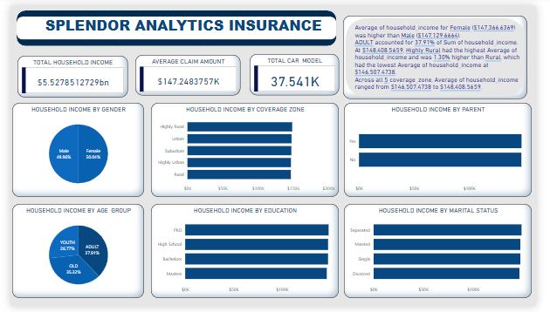
HOUSEHOLD INCOME MODEL

Slide 12
Customer Segmentation and Marketing
What are the key characteristics of policyholders with low claim frequencies and high household incomes?
Age Group - Adult policyholders have low claim frequencies and high household income.
Education - Bachelors degree policyholders have low claim frequencies and high household income.
Marital Status - Separated policyholders have low claim frequencies and high household income.
How can we segment the customer base to identify high-value customers for targeted marketing campaigns?
To segment the customer base and identify high-value customers for targeted marketing campaigns, start by identifying key segments with the highest potential value. We focus on segments with characteristics such as high average policy premiums, low claim frequency, and a high number of policies.
Therefore, targeting policyholders who are separated, hold a bachelor's degree, and are adults could be an effective strategy for marketing campaigns.

Slide 13
DEMOGRAPHIC ANALYSIS
Age Group- policy holders at Adult are high risk commercial users, Youth are also very high risk private users.
Gender- evenly distributed with insignificant differences on all filters
Marital status- Single people are high risk while separated policy holders are very low risk policy holders for both commercial and private users.
The noticeable trend is that gender have insignificant difference and Single people are high risk policyholders for commercial and private car users.

Slide 14
GEOGRAPHICAL ANALYSIS
Without filters, policy holders staying in Suburban zones have the highest claim frequency follow by Highly urban, Urban, Rural and Highly rural makes the least claim frequency while policy holders staying in Urban zones have the highest claim amount follow by Suburban, Highly rural, Highly urban and Rural makes the least claim amount .
Commercial car users- policy holders staying in Highly Urban zones have the highest claim frequency follow by Highly Rural, Rural, Urban and Suburban makes the least claim frequency while policy holders staying in Urban zones have the highest most claim amount follow by Suburban, Rural, Highly Rural, and Highly urban makes the least claim amount.
Private car users- policy holders staying in Suburban zones have the highest claim frequency follow by Highly Urban, Urban, Rural and Highly Rural makes the least claim frequency while policy holders staying in Highly Rural zones have the highest claim amount follow by Urban, Highly Urban, Suburban and Rural makes the least claim amount.
Trends or Pattern
Suburban zones have the highest claim frequency for both without filter and Private cars users
Urban zone have the least claim amount for both without filter and commercial car users.
Rural zone have the least claim amount for both without filter and commercial car users.

Slide 15
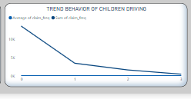
Customer Behavior Insights
The policyholder having Four kids have the highest frequency follow by the policyholder having None and One kids then policyholder having Two kids.
The number of claims start to declined from policyholder having One kids

Slide 16
THANKS SO MUCH

